Slide 1
Inverse Design via Machine Learning
Shengnan Han

Slide 2
Last Week
Generate 1024 sample X
Update algorithm √
See result √

Slide 3
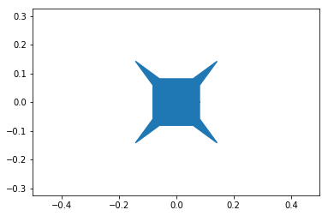
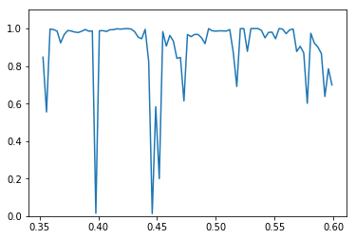
What’s wrong?
Incorrect spectrum:
You: “Simple shape cannot have
complex spectrum”
Reason:
Overlapping points create noise
in the S4
Solution:
Eliminate overlapping points

Slide 4
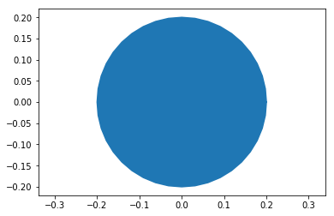
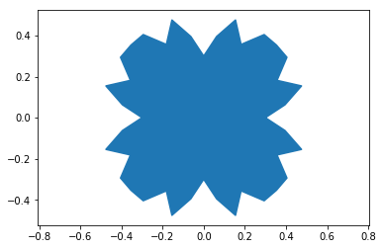
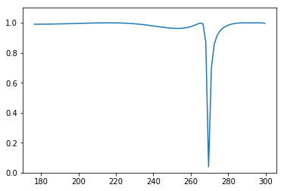
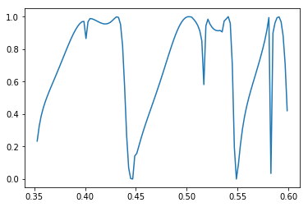
Why this problem was not discovered?
Overlapping point create correct result for both complex shape and simple shape.

Slide 5
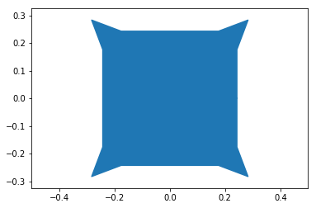
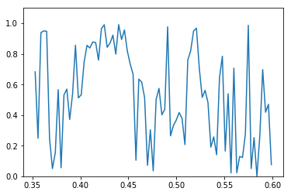
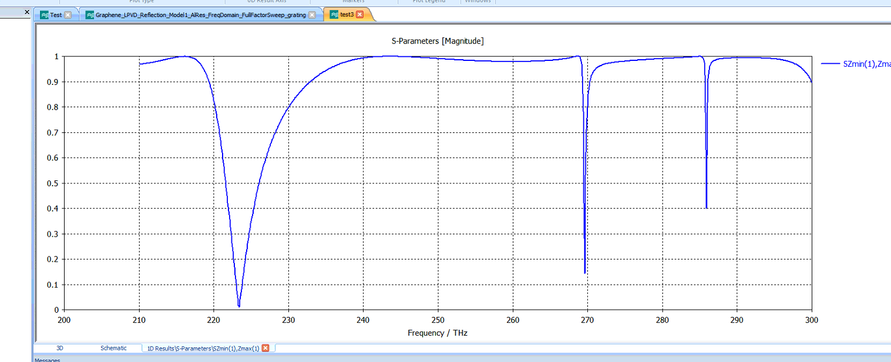
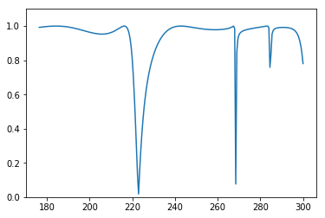
Result of Solution:
Shape
Incorrect Result
CST Result
Solution result

Slide 6
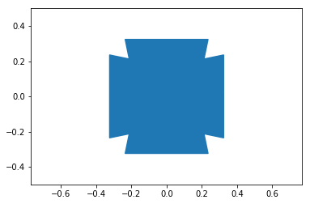
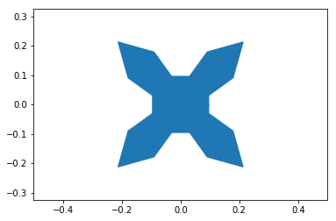
Some algorithm update from last week
Activate and deactivate angle lines->able to generate squares and other strange polygon

Slide 7
Some Algorithm updates from last week
Eliminate coordinate at (0, 0) and every point is at least 0.1 away from (0, 0)
Why?
Some shape don’t produce spectrum if they have points at (0, 0)
Does it affect data set?
Yes, size of data set shrink from 10000+ to 4988. However, it avoids sharp angles and adversary samples.

Slide 8
More problem
Same input different output(Still working on it)

